Slide 2
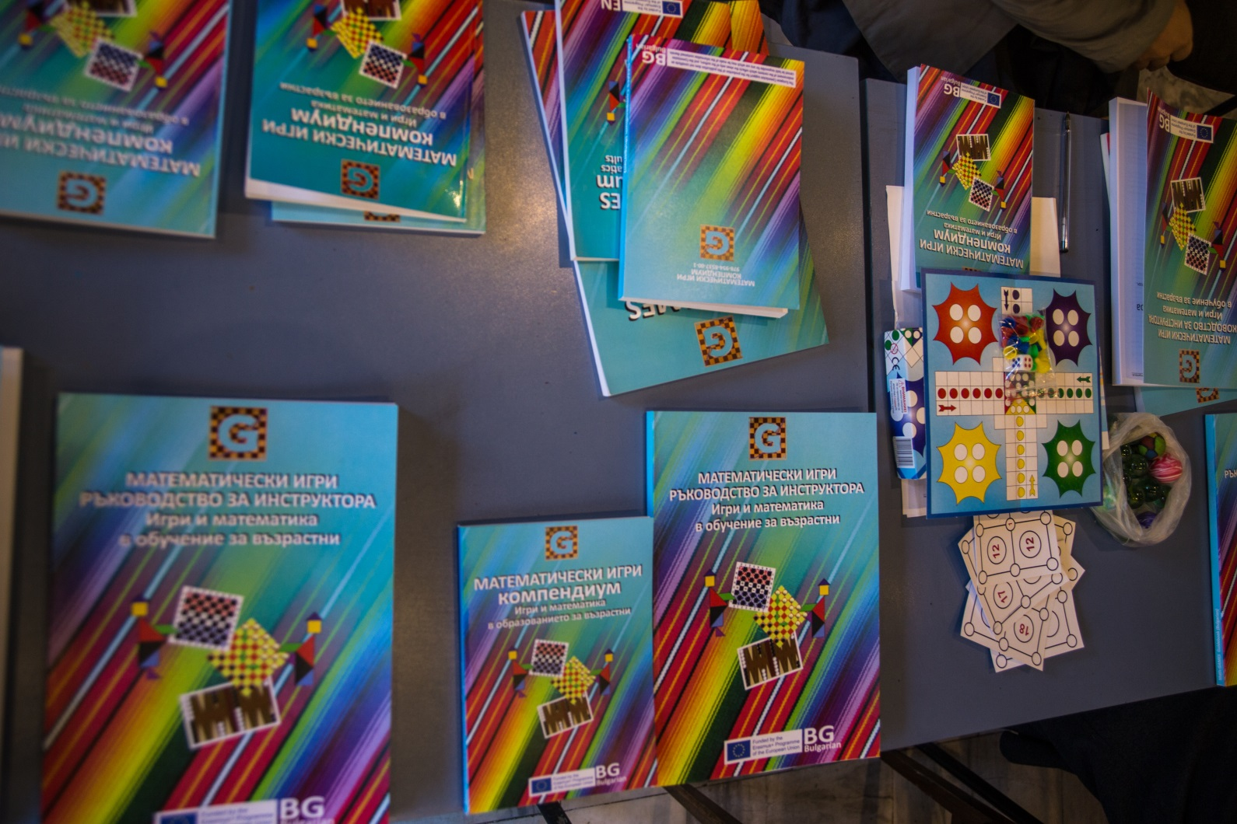
Multiplier Event E10 (Dissemination Conference) in Bulgaria
STEP 1. After the publishing of the two books with collections of Math-GAMES, we started preparing the Multiplier Event E10 (Dissemination Conference) in Bulgaria.

Slide 3
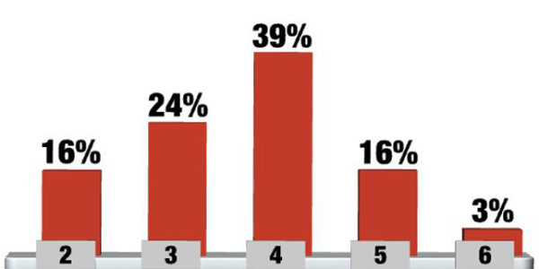
Multiplier Event E10 (Dissemination Conference) in Bulgaria
STEP 2. In order to discuss how to get to different audiences, we organized a preliminary event with 3 teachers, 2 programmers, 3 lecturers, 3 students, 2 university students - a total of 13 people who we well know. All of them knew they were participating in an experiment, the purpose of which was to understand the strengths and weaknesses in conducting the actual event. It took place on September, 10, for 2 hours in a special small hall of the so-called " Business incubator” in Kardzhali.
The participants got acquainted with the two published books in Bulgarian, the aims of the Math-GAMES project and its methodology, as well as the three developed Bulgarian games as a basis for mathematics training.
At the end, the participants did not give a particularly appreciative estimate of the event and we had to analyze the reasons.
From the filled in questionnaires, the following conclusion can be drawn: about 3% satisfaction is expressed by the youngest participants, about 16% is the satisfaction of the narrow specialists - programmers, lecturers, 24% are those who are interested in participating in a wider forum, with more opportunity for information and discussion, 39% is the satisfaction of the older and more experienced in the field of teaching people. Of course it’s not really a representative extract.

Slide 4
Multiplier Event E10 (Dissemination Conference) in Bulgaria
STEP 3. At the end, the participants did not give a particularly appreciative estimate of the event and we had to analyze the reasons.
After discussing with our experts, we summarized 4 main reasons:
The audience is very heterogeneous;
Younger participants appreciate the structure of the presentation as too complex;
The participants - teachers and lecturers - are mainly interested in the methodology of playing games as a learning tool;
Experts with narrow specialization in mathematics are mainly interested in the methodology used.

Slide 5
Multiplier Event E10 (Dissemination Conference) in Bulgaria: a Event-Report
STEP 4. After this not a very successful experiment, we prepared and organized two events on two consecutive days (October 3 and 4) aimed not only at presenting the Math-GAMES project and the used methodologies but also to present specific game treatment, algebraic structures of various games included in the project, and how to make them applicable to mathematics training.
Why two?
The first Teacher Training event (October 3, 2017) was attended by mathematics teachers and young programmers from Sofia, Plovdiv, Kardzhali and Haskovo. Some of them have worked with a variety of learners from different ethnic groups, residents of remote rural areas, refugees, unemployed, etc.
The second event (October 4, 2017) was attended by University students from mathematics specialties from Sofia and Plovdiv and students with achievements and awards in the field of mathematics from Kardzhali.
Both main lecturers have scientific developments in the field of mathematics and have participated in the compilation and mathematical development of the Bulgarian part of the Math-GAMES publications.

Slide 6
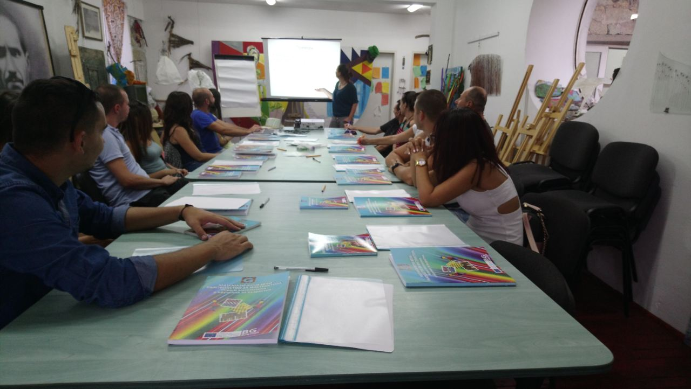
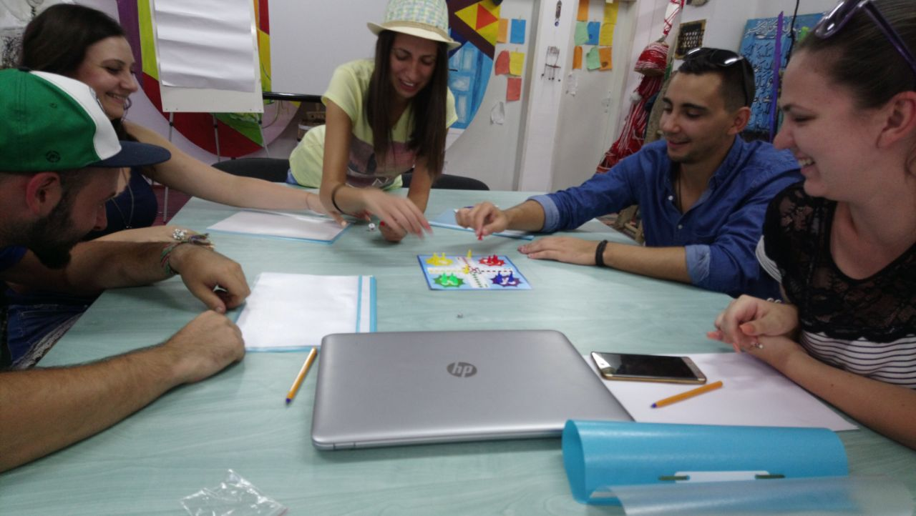
Multiplier Event E10 (Dissemination Conference) in Bulgaria
In the Training day on October, 3 we presented:
the Math-GAMES methodology of playing games as a learning tool;
the possible lesson’ structures on the base of Math-GAMES methodology;
the published project books as didactically books – a collection of ideas and experiences based on the curricula, how these games can help numeracy (learning to count and calculate, learning basics in Mathematics, Statistics and Geometry).
During the second part of the training day the participants had the opportunity:
to play the three Bulgarian games from the published books, and to comment on the mathematical content in them.

Slide 7
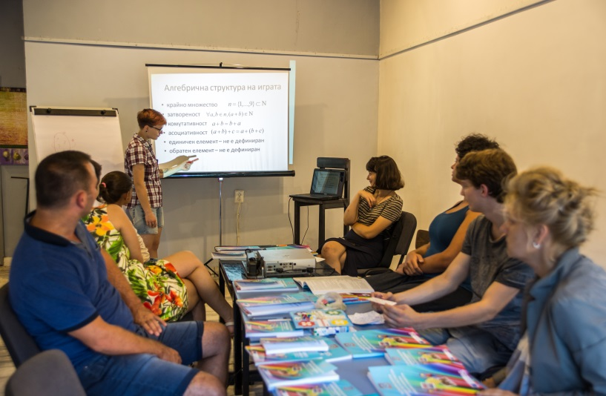
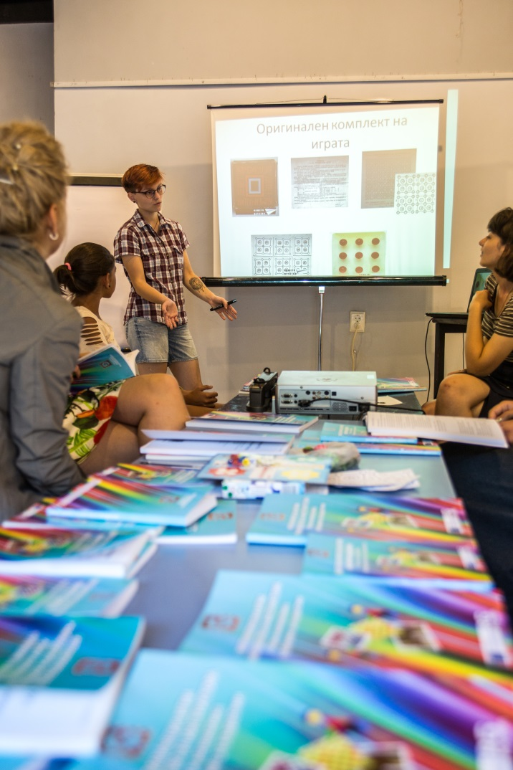
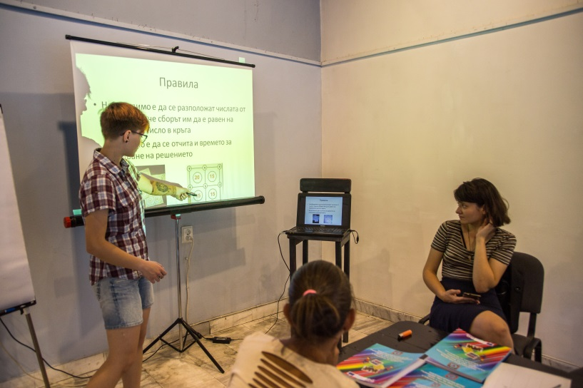
Multiplier Event E10 (Dissemination Conference) in Bulgaria
The second event (October 4, 2017) was attended by University students from mathematics specialties from Sofia and Plovdiv and students with achievements and awards in the field of mathematics from Kardzhali. The main focus was the methods of mathematical modeling of traditional games and their algebraic structures.

Slide 8
Multiplier Event E10 (Dissemination Conference) in Bulgaria
The working time, incl. coffee breaks on the first day were 4 hours and on the second day - 3 hours. Math-GAMES Methodology was presented; the algebraic structures of the 3 Bulgarian games were demonstrated with which we wanted to explain how the methodology works. Two games to play with the participants were prepared. Each participant got 1 Compendium, 1 Guidebook in Bulgarian language and 1 USB stick with the Teacher-Training-Course. All participants completed an on-line Evaluation Survey in Bulgarian on the Project Math-GAMES site.

Slide 9
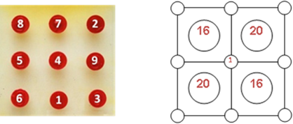
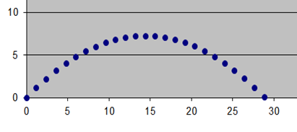
Multiplier Event E10 (Dissemination Conference) in Bulgaria
Despite what has been done to promote Math-GAMES methodology up to now, we think it’s not enough.
We are currently in the process of negotiating with representatives of the Faculty of Mathematics and Informatics of the University of Plovdiv in order to organise a presentation with their lecturers and/or students in the future.

Slide 10
Thank you for your attention!

